Slide 1
Public Benefit Status
Phil Cooper of the Greenacre Group UK
Presentation for the northern part of Cyprus

Slide 2
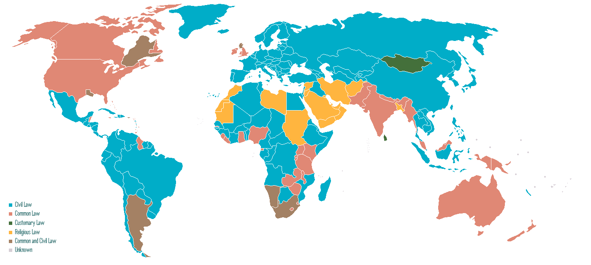
Different Legal Systems

Slide 3
Different legal systems- 2
Civil Law
Based upon legal recognition of associations and foundations;
Focus on legal form;
Legal codes (codex);
Examples;
Continental Europe (France, Germany, Spain, Italy)
and their former colonies (Vietnam, Mexico, Senegal)
Common Law:
Based upon legal recognition of charitable purposes
Focus on use of funds;
Case law (precedent);
Examples:
England
USA
Australia
former British Empire

Slide 4
Public Benefit – definition and significance
A descriptive but not legal term
A legal test used to define the NGO sector (common law system)
A means of selecting a part of the NGO sector for additional benefits (many civil law countries)

Slide 5
Reasons for a Public Benefit Status
PBOs do good – they are a benefit to society
PBOs are foreign, independent and rich - they threaten stability
Enabling Controlling
Understand the sector Identify and monitor PBOs
Legal space to operate Shape the sector
Financial support Create stakeholders in the state
Help poor NGOs do better Stop poor NGOs from operating
Prevention Cure

Slide 6
How Public Benefit Status works
Rights
Right to operate
Sole or preferential access to...
Tax exemptions
Government grants
Overseas funds
Limitations on liability
Right to PBO name
Responsibilities
Notify or register with authorities
Limited permitted activities
Adopt approved legal and/or governance structures
Subject to inspection and/or audit
Transparency to authorities and/or public
Accounting standards

Slide 7
What is Public Benefit? Charities Act 2006 (England)
the prevention or relief of poverty;
the advancement of education;
the advancement of religion;
the advancement of health or the saving of lives;
the advancement of citizenship or community development;
the advancement of the arts, culture, heritage or science;
the advancement of amateur sport;
the advancement of human rights, conflict resolution or reconciliation, or the promotion of religious or racial harmony or equality and diversity;

Slide 8
What is Public Benefit? Charities Act 2006 (England)
the advancement of environmental protection or improvement;
the relief of those in need by reason of youth, age, ill-health, disability, financial hardship or other disadvantage;
the advancement of animal welfare;
the promotion of the efficiency of the armed forces of the Crown, or of the efficiency of the police, fire and rescue services or ambulance services; and
other purposes that are currently recognised as charitable or are in the spirit of any purposes currently recognised as charitable.

Slide 9
Public Benefit Tests
Fixed or
flexible definitions
Who applies the
test?
(not always government)
Religious
Arts
Political
Public Benefit Organisations
Exclusive Activities
Profit Making
Government
Sports

Slide 10
When does an organisation merit PBO status?
Starts Public Fund-raising
Gets Overseas funding
Legally Incorporated
Income exceeds US$10,000
Opens Bank Account
Written Constitution
Achieves Best Practice Standards
Trigger Point
Informal Formal
← PBO Life Cycle →

Slide 11
When does an organisation merit PBO status?
Starts Public Fund-raising
Gets Overseas funding
Legally Incorporated
Income exceeds US$10,000
Opens Bank Account
Written Constitution
Achieves Best Practice Standards
Compulsory
Voluntary
Accredited
Informal Formal
← PBO Life Cycle →
Notes:
5

Slide 12
Going forward
Consider what would best fit into exisiting legal frameworks;
Work with the not for profit community;
Consider logistical issues;
Look at international standards
Consult; and
Implement change

Slide 13
Questions and comment's?
Phil Cooper
Director and Senior Consultant
Phil@greenacegroup.co.uk
www.greenacregroup.co.uk

